Slide 1
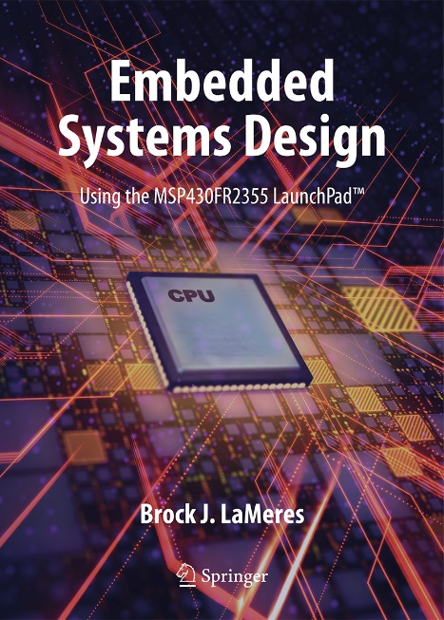
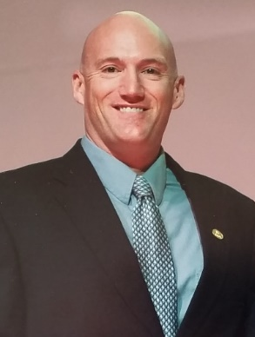
Embedded Systems Design
Chapter 1: Introduction to Embedded Systems
1.1 What is an Embedded System?
Brock J. LaMeres, Ph.D.

Slide 2
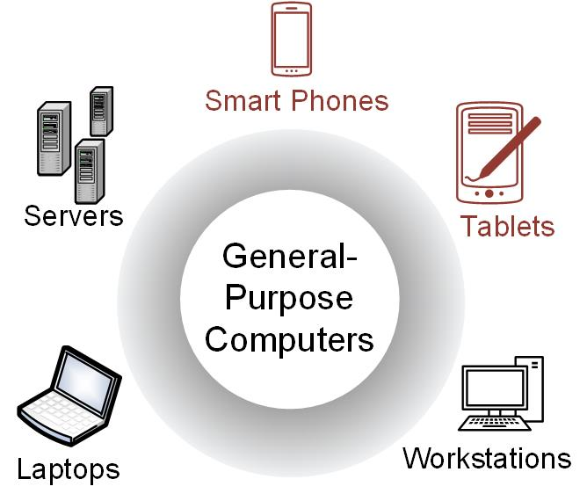
Ch. 1: Introduction to Embedded Systems
General-Purpose Computers
Able to run a variety of software.
Contain relatively high-performance hardware components (fast processors, data & program storage).
Require an operating system (OS).
Image Courtesy of
Recording Connection of Canada
1.1 What is an Embedded System?

Slide 3

Ch. 1: Introduction to Embedded Systems
General-Purpose Computers
Designed for heavy user interaction.
Uses a variety of peripherals (displays, keyboards, mice, internet connections, wireless communication capability).
Expensive ($100s - $1000s).
Use a group of integrated circuits or chips (ICs).
One implements the central processing unit (CPU).
Several implement data memory and program storage.
Possesses a distributed architecture (full functionality of the computer is spread across multiple IC chips).
Image Courtesy of
Recording Connection of Canada
1.1 What is an Embedded System?

Slide 4
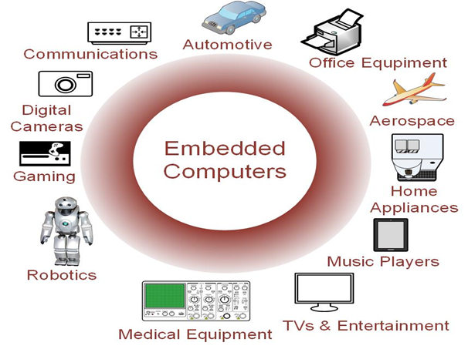
Ch. 1: Introduction to Embedded Systems
Embedded Computers
Resources can be implemented on a single IC.
Include a variety of peripherals (timers, analog-to-digital converters, digital-to-analog converters, serial interfaces).
Small size makes them very versatile.
Image Courtesy of
Recording Connection of Canada
1.1 What is an Embedded System?

Slide 5
Ch. 1: Introduction to Embedded Systems
Embedded Computers
Contains firmware (only the needed software which is not intended to be changed frequently).
May contain Real Time Operating Systems (RTOS) which are used as a task scheduler.
Low cost (10s of cents to a few dollars).
Image Courtesy of
Recording Connection of Canada
1.1 What is an Embedded System?

Slide 6
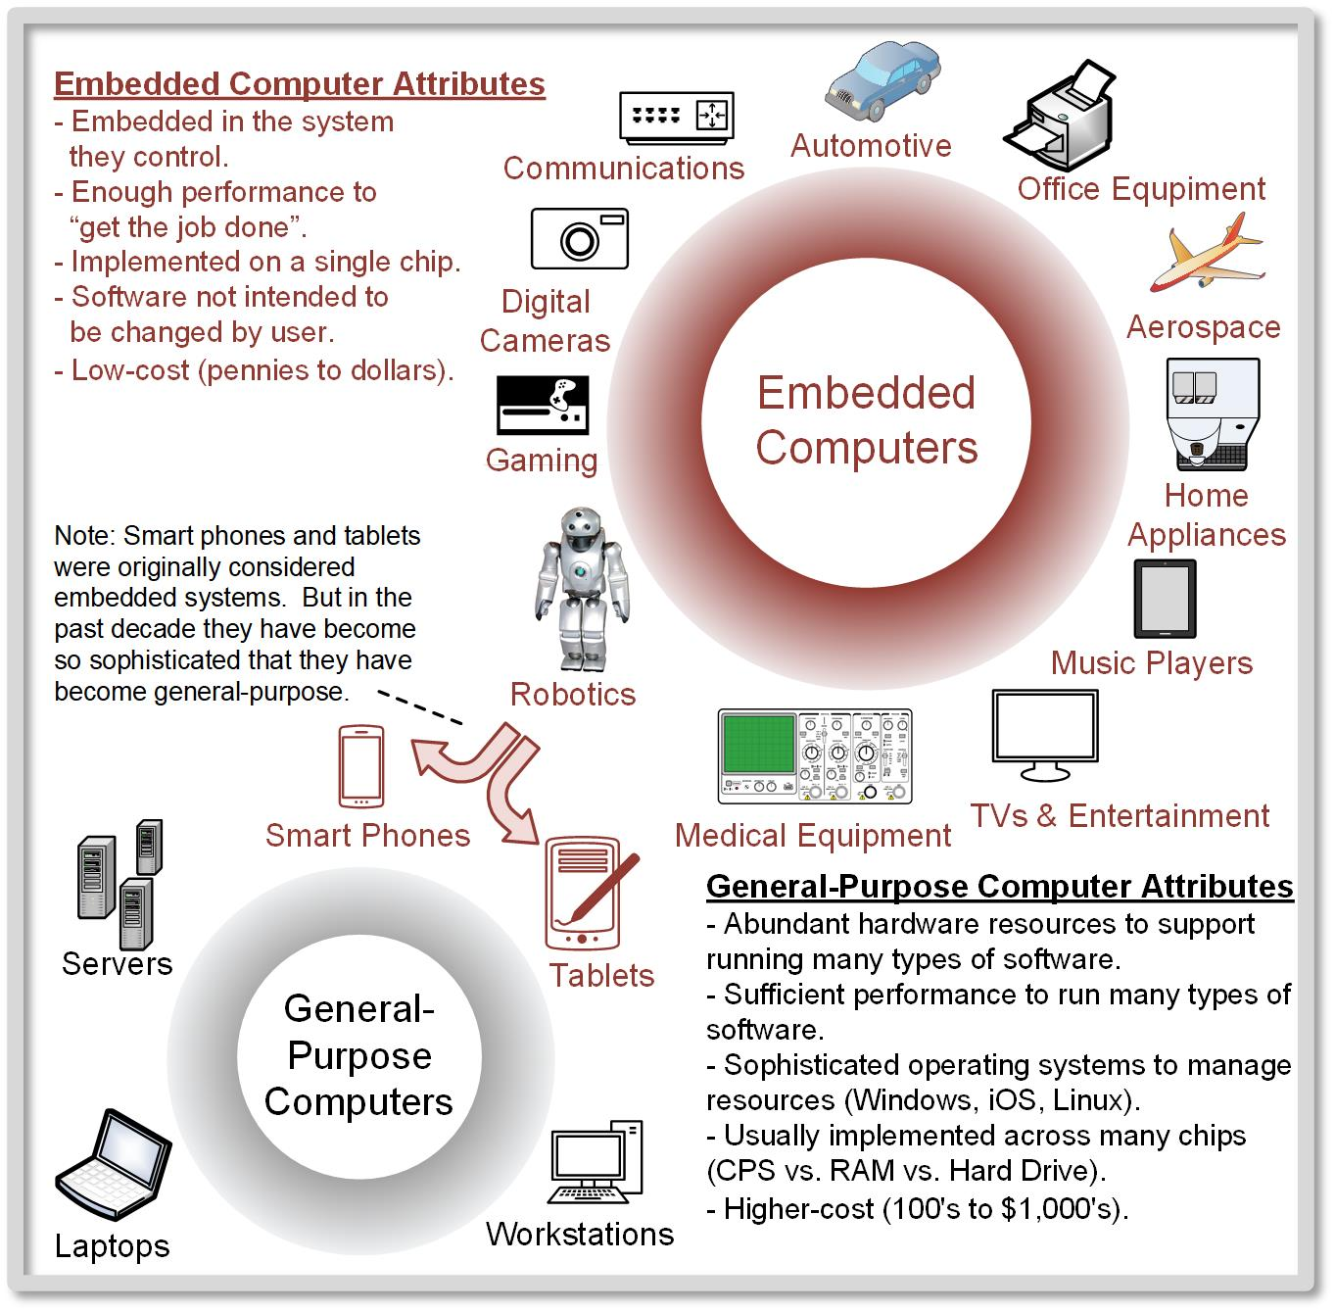
Ch. 1: Introduction to Embedded Systems
Embedded Computers
Image Courtesy of
Recording Connection of Canada
1.1 What is an Embedded System?

Slide 7

Embedded Systems Design
Chapter 1: Introduction to Embedded Systems
1.1 What is an Embedded System?
www.youtube.com/c/DigitalLogicProgramming_LaMeres
Brock J. LaMeres, Ph.D.

